Slide 1
DEEP LEARNING CA2 PART A: Generative Adversarial Networks (GAN)
By: Yek Yi Wei (p2107631)
Diploma in Applied AI & Analytics

Slide 2
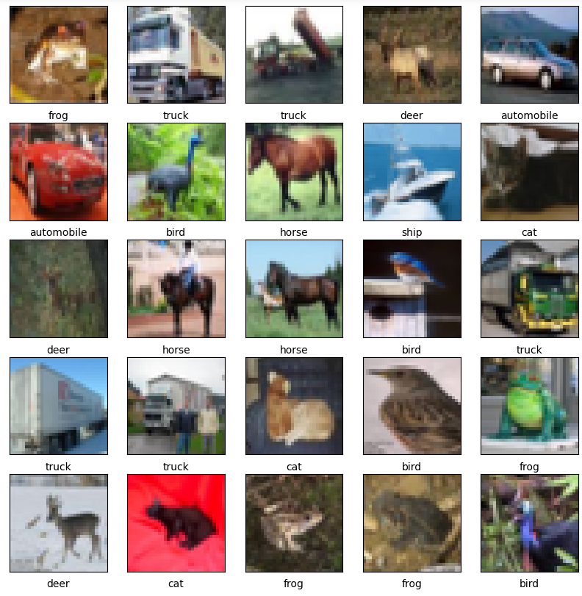
Background Research
The cifar10 dataset was created by Canadian Institute For Advanced Research (CIFAR) and is often used as a benchmark for computer vision and machine learning algorithms. The small size of the images and the number of classes makes CIFAR-10 a good starting point for testing and comparing the performance of different models.

Slide 3
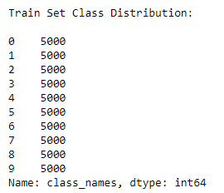
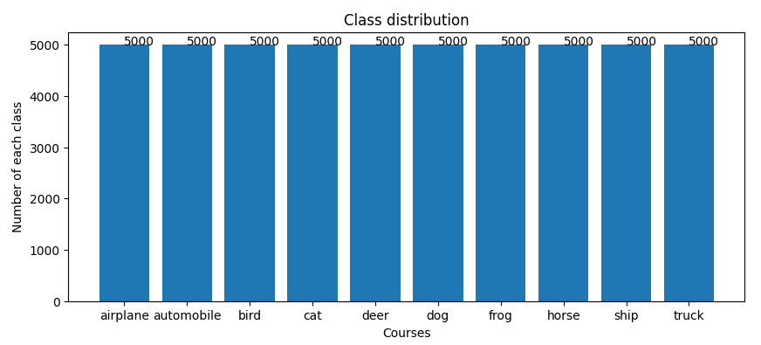
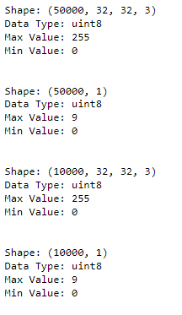
exploratory data analysis

Slide 4
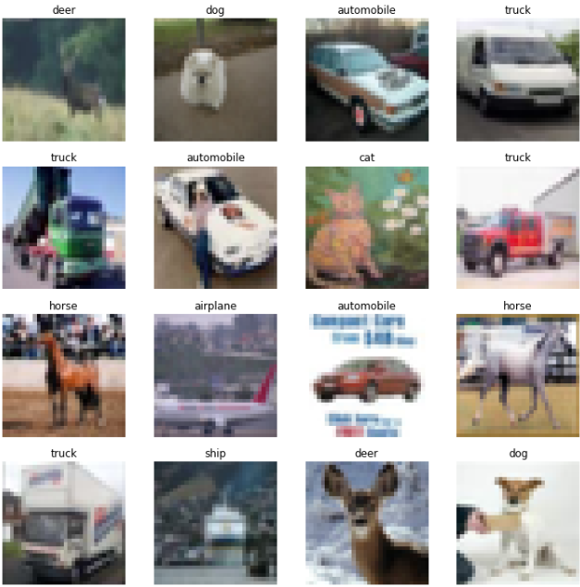
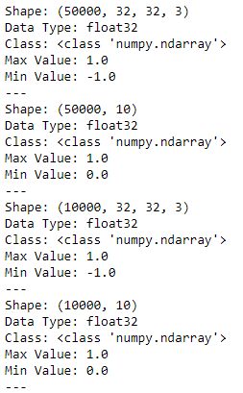
DATA PREPROCESSING
Before
After
Display the 16 random images from the training set and display the class name above each image.
Using min max normalization to scale the data to -1 to 1 to match the output of generator
The training set and the testing set are preprocessed in the same way

Slide 5
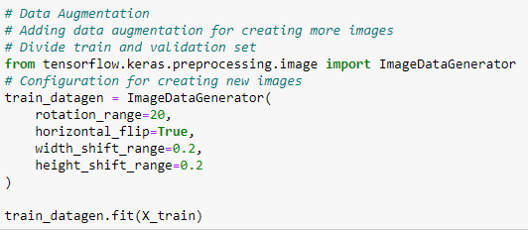
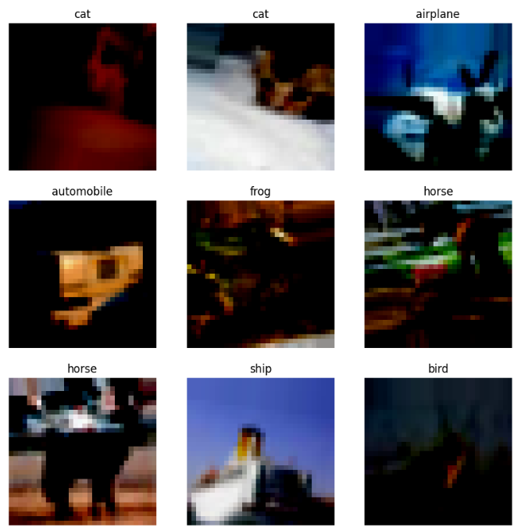
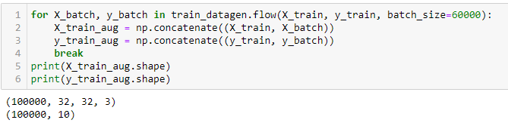
DATA AUGMENTATION
- rotation_range (Degree range for random rotations)
- horizontal_flip (Randomly flip inputs horizontally)
- width_shift_range (Range for random horizontal shifts)
- height_shift_range (Range for random vertical shifts)
Adding the Augmented Data to the default data
- Number of Rows x 2

Slide 6
Training Process- Refer to code
Initialize the generator and discriminator networks
Generate fake samples
Evaluate fake samples
Train the discriminator network
Train the generator network
Save the generator network

Slide 7
Model evaluation
Manual Evaluation
Using your eyes to check which generated image is the best at a specific epoch
Fréchet Inception Distance (FID)
The FID can be used to evaluate generative models by calculating the FID between real and fake data distributions
Inception Score (IS)
The IS can be used to evaluate the quality of generated images, specifically synthetic images output by generative adversarial network models.

Slide 8
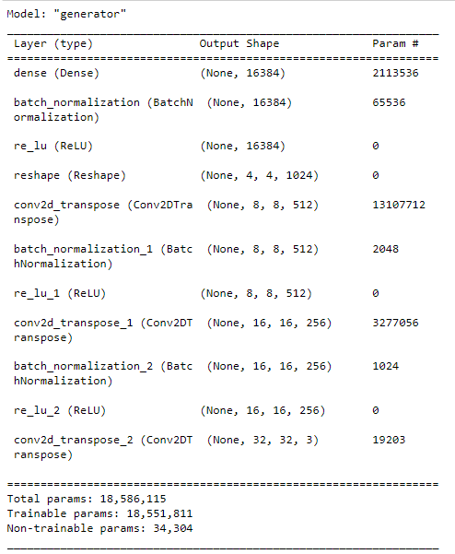
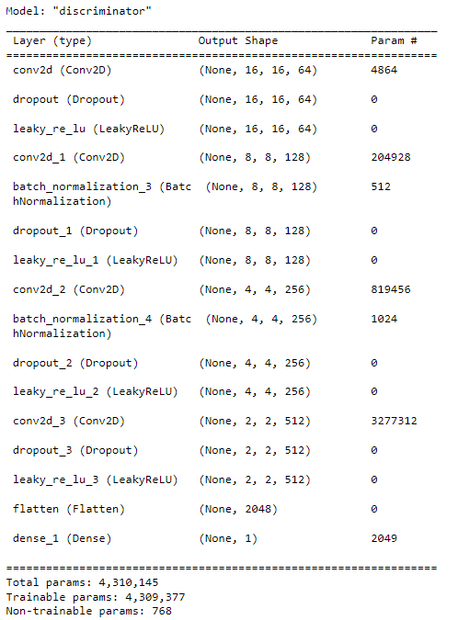
BASE_MODEL

Slide 9
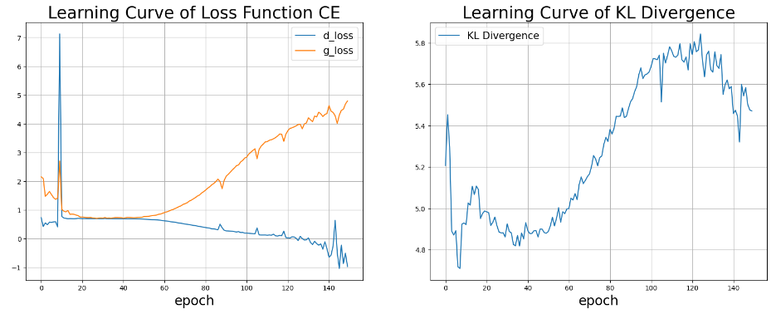
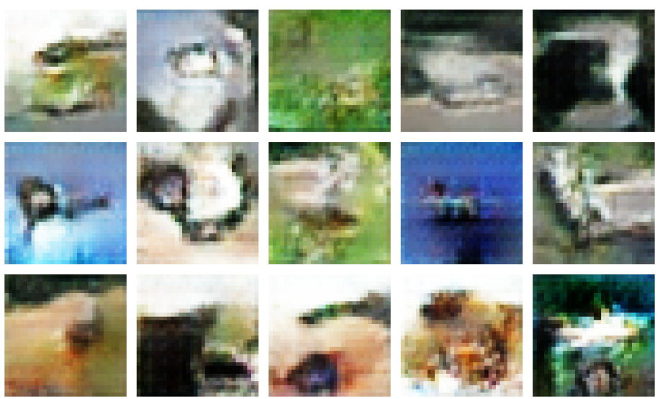
Model Evaluation – Baseline Model
FID: 130.94
IS: 1.01
Converges at around 20 to 50 epoch
More stationary at 20 to 50 epoch
Generation Image at 50 epoch

Slide 10
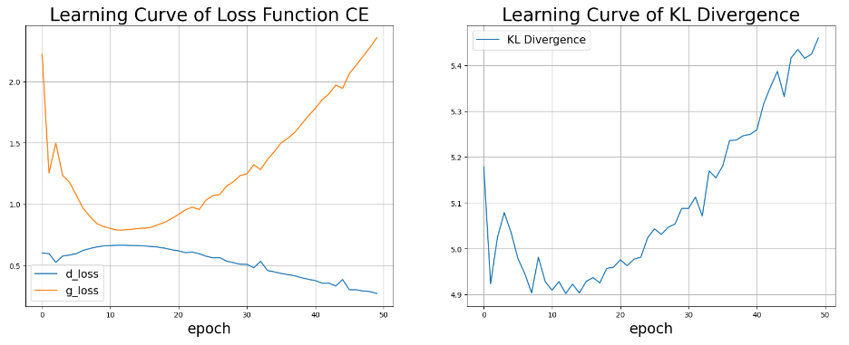
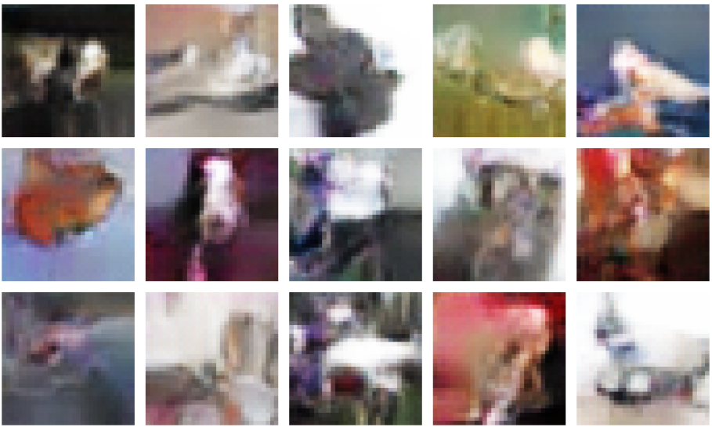
Model Evaluation – Baseline Model (With data augmentation)
FID: 115.24
IS: 1.005
Generated Image at 20 epoch
Converges more at around 10 to 20 epoch
More stationary at 10 to 20 epoch

Slide 11
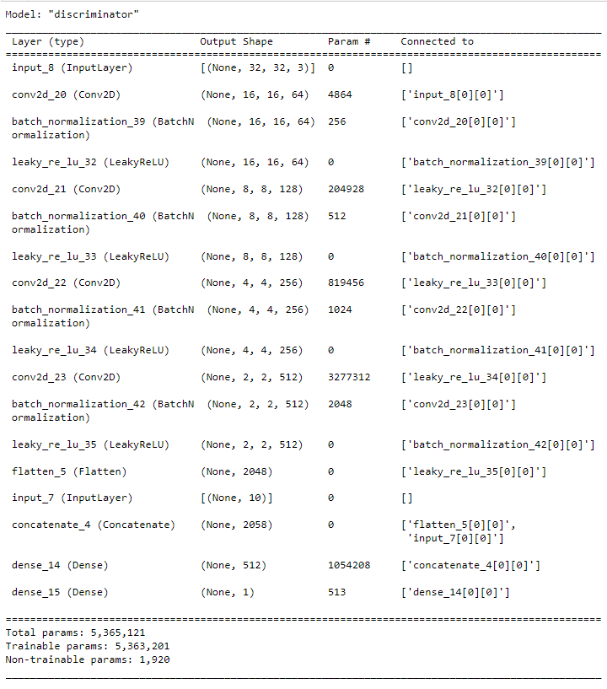
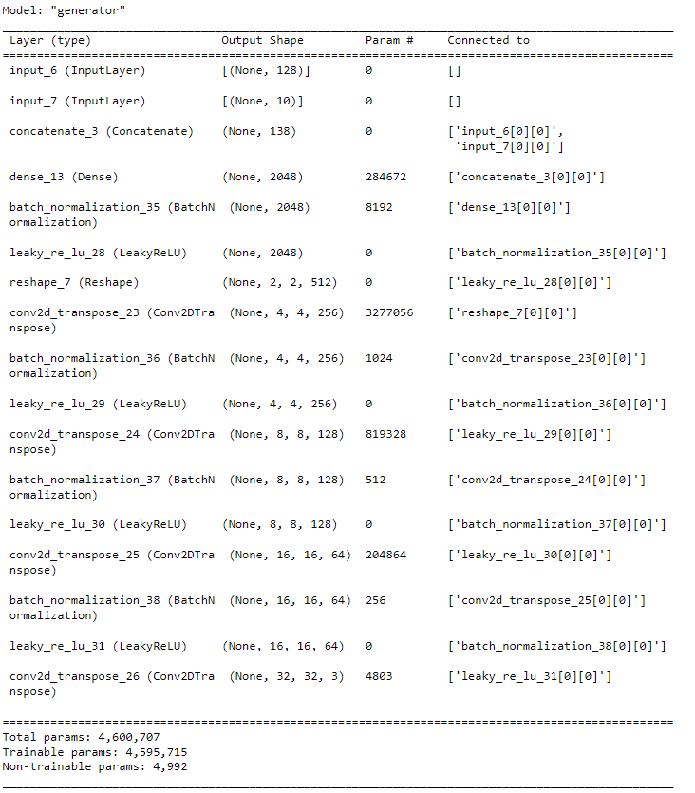
CGAN MODEL

Slide 12
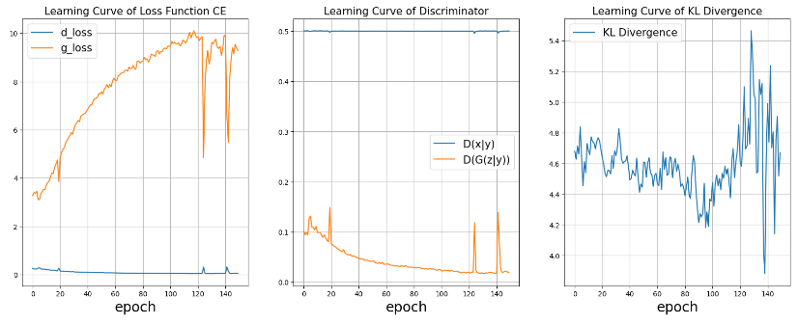
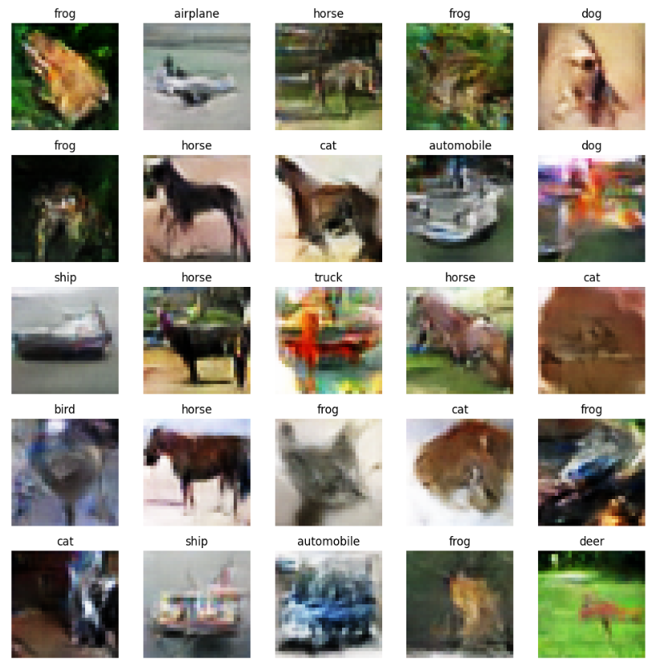
Model Evaluation – CGAN
FID: 91.33
IS: 6.50
More stationary from 10 to 100 epoch
Generated Image at 100 epoch

Slide 13
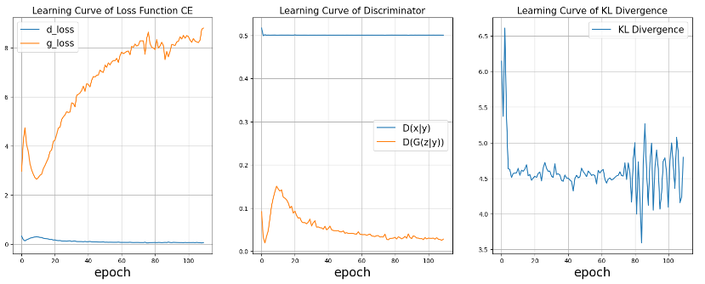
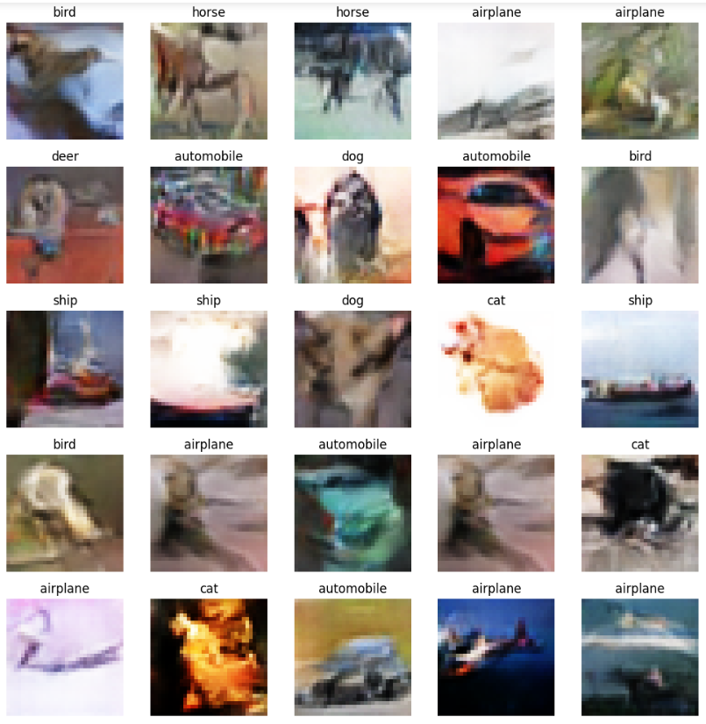
Model Evaluation – CGAN (With data augmentation)
FID: 103.57
IS: 5.51
More stationary from 10 to 80 epoch
Generated Image at 50 epoch

Slide 14
Conclusion-Data Augmentation
Model | FID score | IS score
Base Model | 130.94 | 1.01
Base Model Aug | 115.24 | 1.005
CGAN Model | 91.33 | 6.50
CGAN Model Aug | 103.57 | 5.51
The best model was CGAN without Data Augmentation with the highest inception_score 6.50 and FID of 91.33
Data Augmentation helps if the data is augmented correctly, in this case the basemodel has improved (generating better images and scores) while the CGAN model has deproved (generating worse images and scores). The numper of layers (deepness of the model) also contributes to this as the basemodel has less layer than the CGAN model, and is less likely to be affected.

Slide 15
Further Improvements
Train models with different types of Data Augmentation
Adding Labels into training could improve training and identification
Testing out more GAN Models (WGAN, ACGAN)

